Slide 1
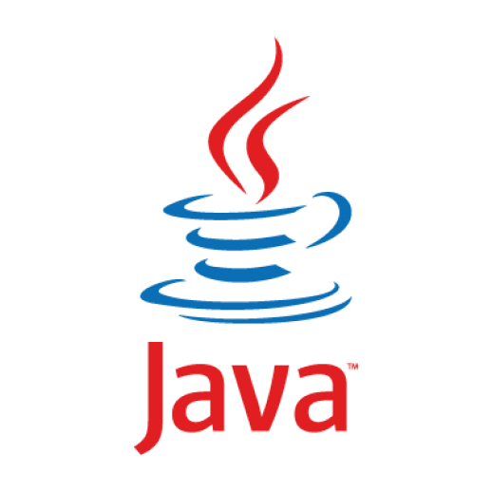

Slide 2
INTRODUCTION TO JAVA

Slide 3
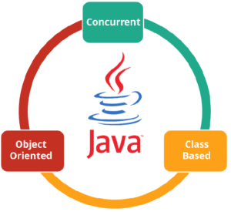
What is JAVA?

Slide 4
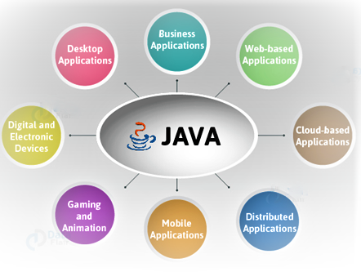
Why JAVA?
The most successful and popular programming language
It was designed for flexibility, allowing developers to write code that would run on any machine, regardless of architecture or platform.

Slide 5
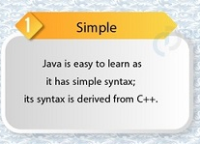
Features

Slide 7
JDK JRE JVM

Slide 8
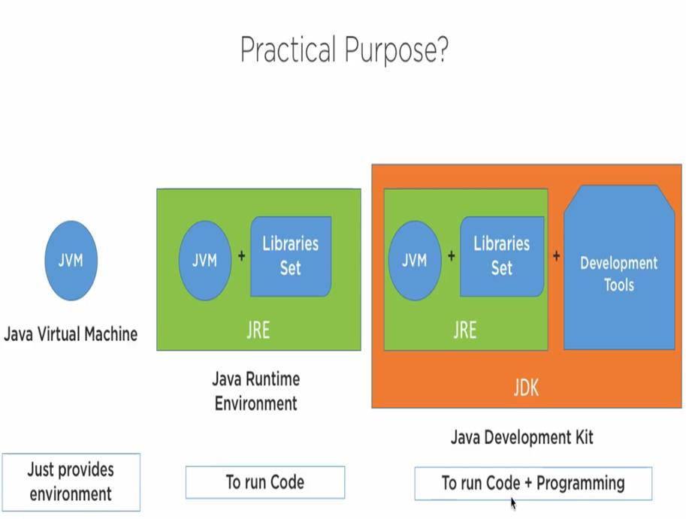

Slide 9
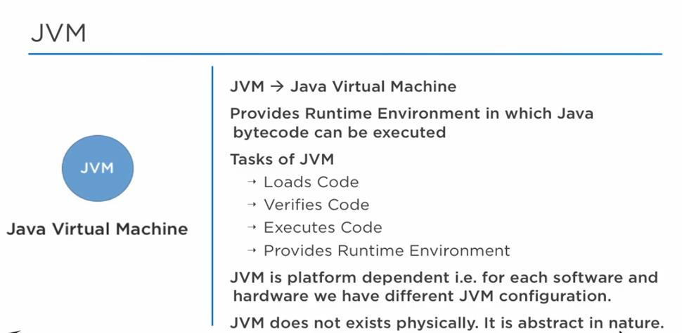

Slide 10
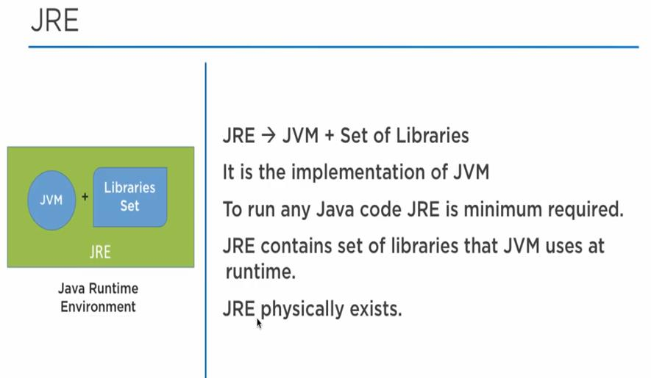

Slide 11
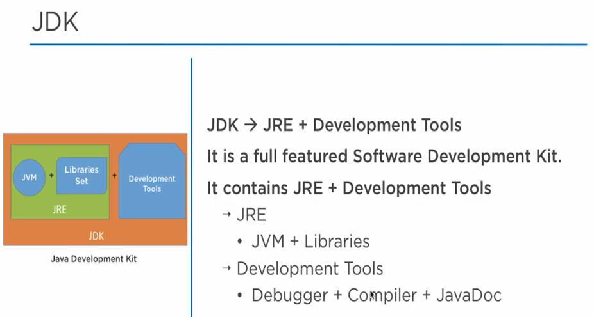

Slide 12
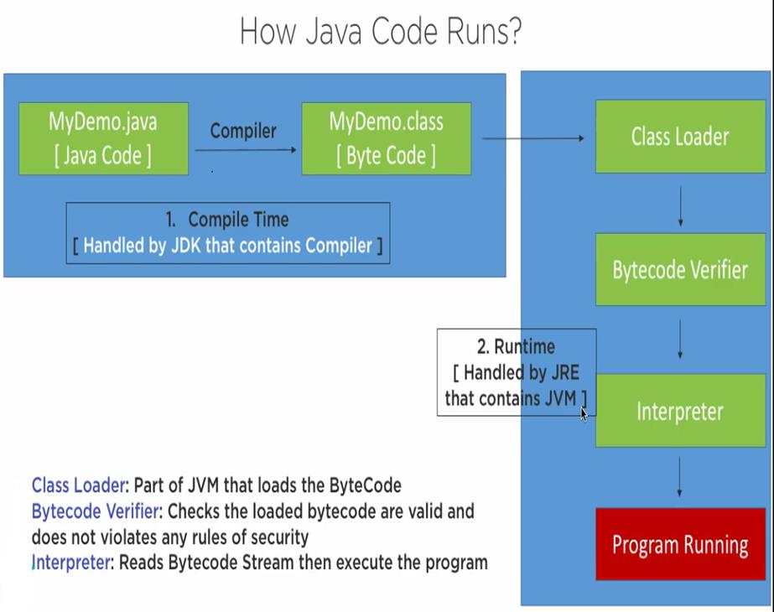

Slide 13
DATA TYPES
Primitive Data Types: This data type is pre-defined by the programming language. The size and type of variable values are specified, and it has no additional methods.
Non-Primitive Data Types: These are not actually defined by the programming language but are created by the programmer. They are also called “reference variables” or “object references” since they reference a memory location which stores the data.

Slide 14
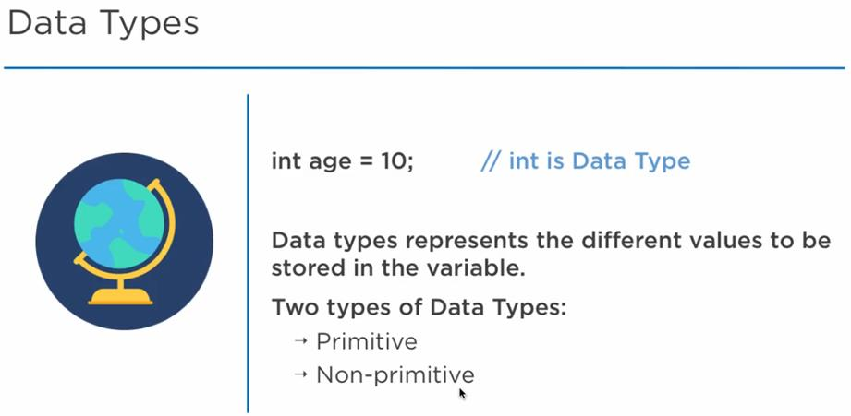

Slide 15
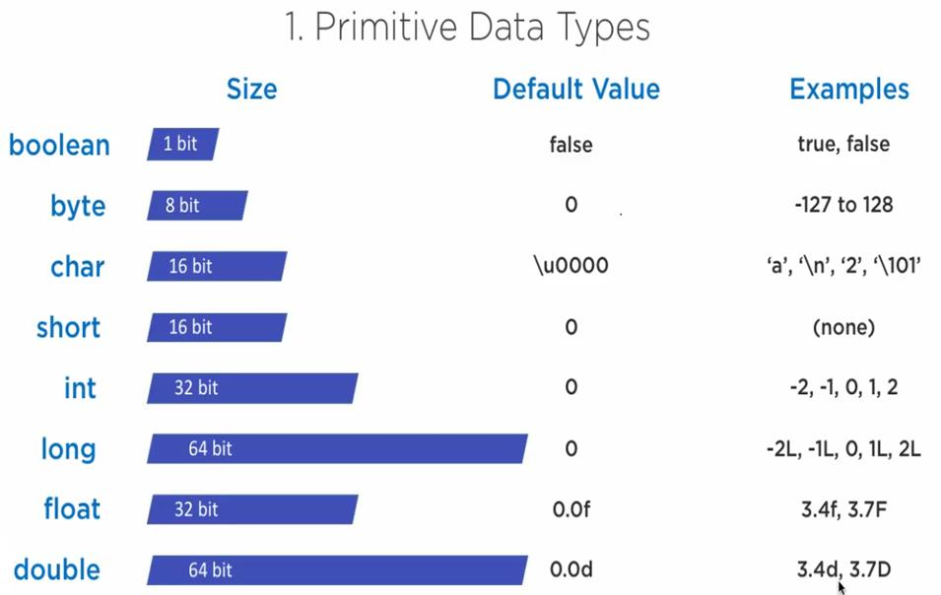

Slide 16
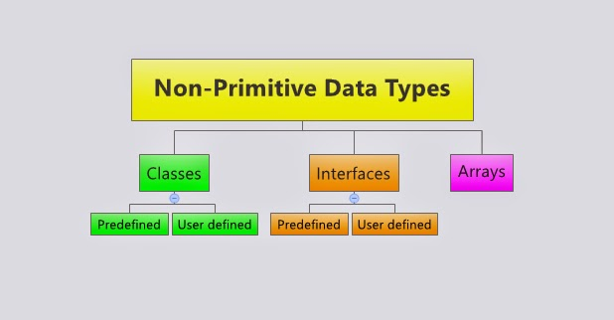

Slide 17
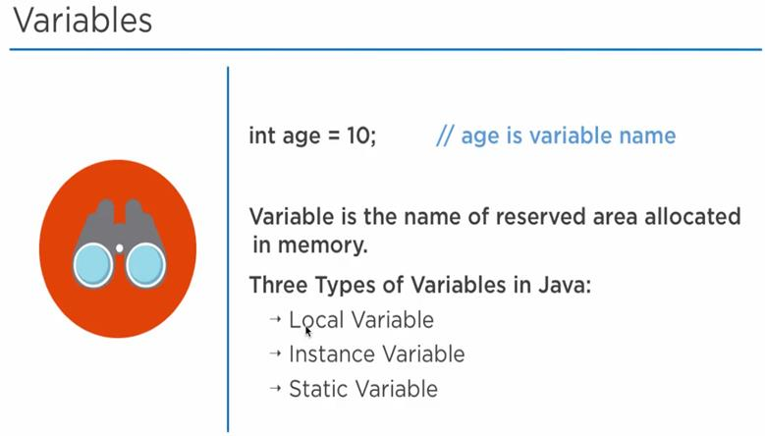
VARIABLES IN JAVA
Variable is a name given to a memory location

Slide 18
Local Variables: defined within a block, a method, or a constructor of the program.
Instance Variable: declared in a class, outside a block, a method, or a constructor. They are non-static.
Static Variable: Similar in nature to Instance Variables. Difference is that they are declared using the static keyword and only a single copy of a static variable per class is allowed.

Slide 19
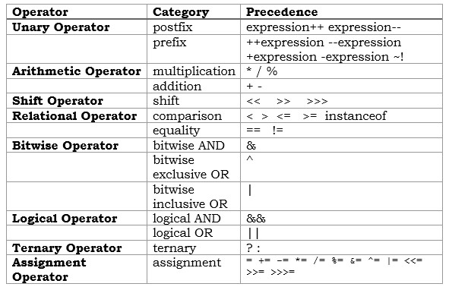

Slide 20
Examples

